Slide 1
INT222 Advance Web Development
BY : DIVYA THAKUR
UID:28300

Slide 2
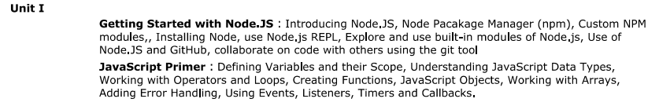

Slide 3
JAVASCRIPT PRIMER

Slide 4
Why is it called JavaScript?
When JavaScript was created, it initially had another name: “LiveScript”.
But Java was very popular at that time, so it was decided that positioning a new language as a “younger brother” of Java would help.
But as it evolved, JavaScript became a fully independent language with its own specification called ECMAScript, and now it has no relation to Java at all.

Slide 5
JAVASCRIPT
JavaScript was initially created to “make web pages alive”.
The programs in this language are called scripts. They can be written right in a web page’s HTML and run automatically as the page loads.
Scripts are provided and executed as plain text. They don’t need special preparation or compilation to run.
In this aspect, JavaScript is very different from another language called Java.
Today, JavaScript can execute not only in the browser, but also on the server, or actually on any device that has a special program called the JavaScript engine.
The browser has an embedded engine sometimes called a “JavaScript virtual machine”.

Slide 6
CODE EDITORS
There are two main types of code editors: IDEs and lightweight editorS :
IDE
The term IDE (Integrated Development Environment) refers to a powerful editor with many features that usually operates on a “whole project.” As the name suggests, it’s not just an editor, but a full-scale “development environment.”
An IDE loads the project (which can be many files), allows navigation between files, provides autocompletion based on the whole project (not just the open file), and integrates with a version management system (like git), a testing environment, and other “project-level” stuff.
Consider the following options:
Visual Studio Code (cross-platform, free).
WebStorm (cross-platform, paid).

Slide 7
Lightweight editors
“Lightweight editors” are not as powerful as IDEs, but they’re fast, elegant and simple.
They are mainly used to open and edit a file instantly.
The main difference between a “lightweight editor” and an “IDE” is that an IDE works on a project-level, so it loads much more data on start, analyzes the project structure if needed and so on. A lightweight editor is much faster if we need only one file.
There are many options, for instance:
Sublime Text (cross-platform, shareware).
Notepad++ (Windows, free).
Vim and Emacs .

Slide 8
JAVASCRIPT SYNTAX
JavaScript programs can be inserted almost anywhere into an HTML document (HEAD & BODY)using the <script> tag.
The type and language attributes are not required.
A script in an external file can be inserted with <script src="path/to/script.js"></script>.
EXAMPLE:
<!DOCTYPE HTML>
<html>
<body>
<p>Before the script...</p>
<script>
alert( 'Hello, world!' );
</script>
<p>...After the script.</p>
</body>
</html>

Slide 9
VARIABLES
Most of the time, a JavaScript application needs to work with information. Here are two examples:
An online shop – the information might include goods being sold and a shopping cart.
A chat application – the information might include users, messages, and much more.
Variables are used to store this information.
A variable is a “named storage” for data. We can use variables to store goodies, visitors, and other data.
To create a variable in JavaScript, use the let keyword.
The statement below creates (in other words: declares) a variable with the name “message”:
let message;

Slide 10
Constants:
To declare a constant (unchanging) variable, use const instead of let:
const myBirthday = '18.04.1982';
Variables declared using const are called “constants”. They cannot be reassigned. An attempt to do so would cause an error:
const myBirthday = '18.04.1982';
myBirthday = '01.01.2001'; // error, can't reassign the constant!
When a programmer is sure that a variable will never change, they can declare it with const to guarantee and clearly communicate that fact to everyone.

Slide 11
SCOPE
Scope determines the accessibility (visibility) of variables.
Before ES6 (2015), JavaScript had only Global Scope and Function Scope(local scope)
ES6 introduced two important new JavaScript keywords: let and const.
These two keywords provide Block Scope in JavaScript.

Slide 12
JavaScript has 3 types of scope:
Block scope
Function scope
Global scope
1. Block Scope:
Variables declared inside a { } block cannot be accessed from outside the block:
Variables declared with the var keyword can NOT have block scope.
Variables declared inside a { } block can be accessed from outside the block.
EXAMPLE: {
var x = 2;
}
// x CAN be used here

Slide 13
2. Local Scope
Variables declared within a JavaScript function, become LOCAL to the function , i.e it can only be accessed within a function.
Example:
let a = "hello";
function greet()
{
let b = "World"
console.log(a + b);
}
greet();
console.log(a + b); // error
In the above program, variable a is a global variable and variable b is a local variable. The variable b can be accessed only inside the function greet. Hence, when we try to access variable b outside of the function, an error occurs.

Slide 14
let is Block Scoped:
The let keyword is block-scoped (variable can be accessed only in the immediate block).
Example:
// global variable
let a = 'Hello';
function greet() {
let b = 'World'; // local variable
console.log(a + ' ' + b);
if (b == 'World') {
let c = 'hello'; // block-scoped variable
console.log(a + ' ' + b + ' ' + c);
}
console.log(a + ' ' + b + ' ' + c); // variable c cannot be accessed here
}
greet();

Slide 15
In the above program, variable
a is a global variable. It can be accessed anywhere in the program.
b is a local variable. It can be accessed only inside the function greet.
c is a block-scoped variable. It can be accessed only inside the if statement block.
Hence, in the above program, the first two console.log() work without any issue.
However, we are trying to access the block-scoped variable c outside of the block in the third console.log(). This will throw an error.

Slide 16
3. GLOBAL SCOPE
A variable declared at the top of a program or outside of a function is considered a global scope variable.
Example:
let a = "hello";
function greet () {
console.log(a);
}
greet(); // hello
In the above program, variable a is declared at the top of a program and is a global variable. It means the variable a can be used anywhere in the program.

Slide 17
Note: It is a good practice to avoid using global variables because the value of a global variable can change in different areas in the program. It can introduce unknown results in the program.
In JavaScript, a variable can also be used without declaring it. If a variable is used without declaring it, that variable automatically becomes a global variable.

Slide 18
JAVASCRIPT DATATYPES
A value in JavaScript is always of a certain type. For example, a string or a number.
There are eight basic data types in JavaScript.
We can put any type in a variable. For example, a variable can at one moment be a string and then store a number:
let message = "hello";
message = 123456;
Programming languages that allow such things, such as JavaScript, are called “dynamically typed”, meaning that there exist data types, but variables are not bound to any of them.

Slide 19
Seven primitive data types:
number for numbers of any kind: integer or floating-point, integers are limited by ±(253-1).
bigint for integer numbers of arbitrary length.
string for strings. A string may have zero or more characters, there’s no separate single-character type.
boolean for true/false.
null for unknown values – a standalone type that has a single value null.
undefined for unassigned values – a standalone type that has a single value undefined.
symbol for unique identifiers.
And one non-primitive data type:
object for more complex data structures.

Slide 20
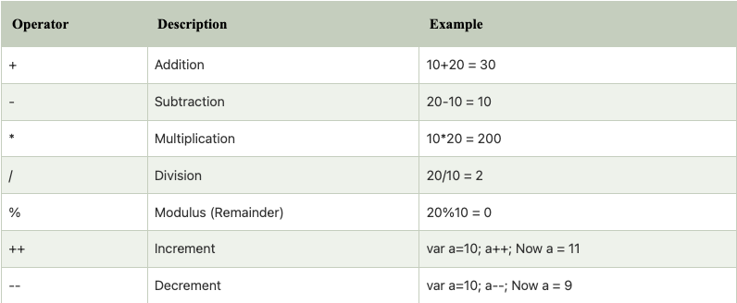
OPERATORS
An operand – is what operators are applied to. For instance, in the multiplication of 5 * 2 there are two operands: the left operand is 5 and the right operand is 2. Sometimes, people call these “arguments” instead of “operands”.
ASSISGNMENT OPERATORS:

Slide 21
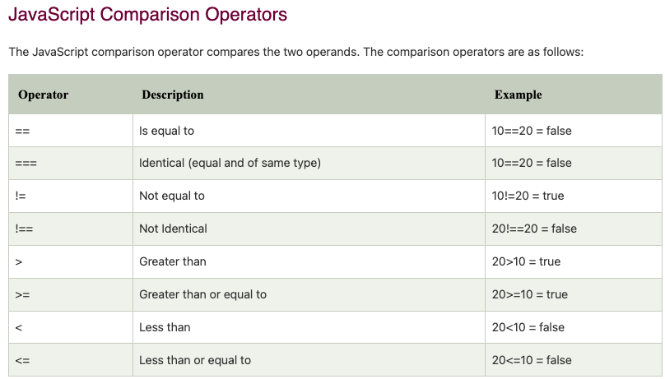

Slide 22
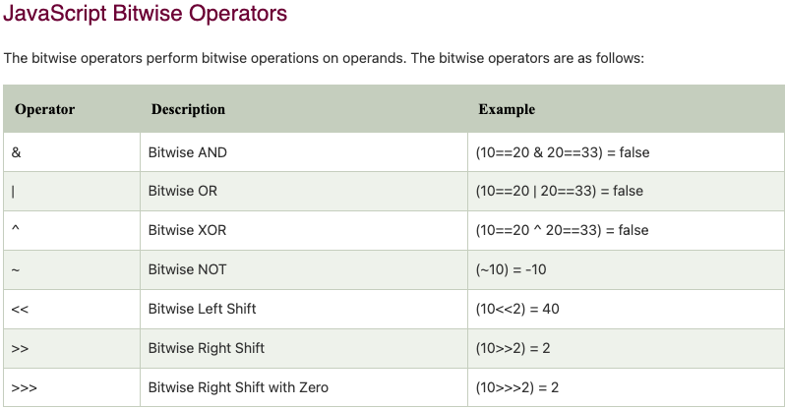

Slide 23
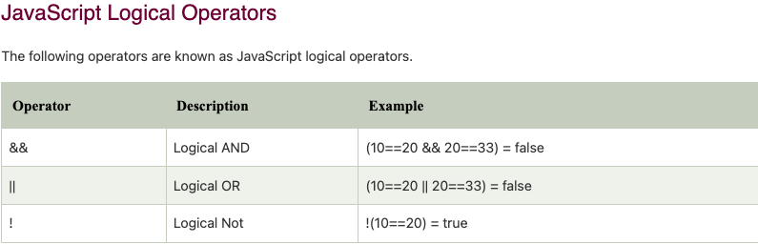
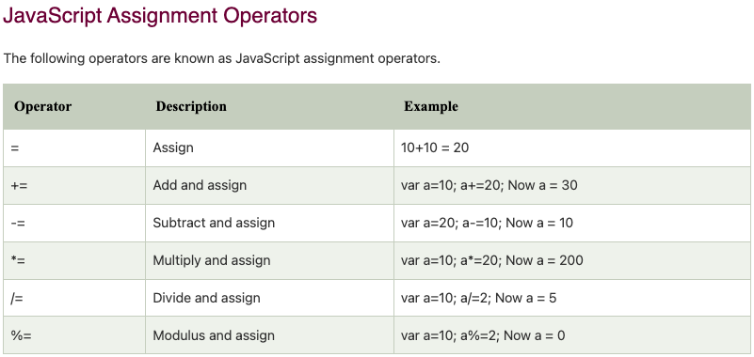

Slide 24
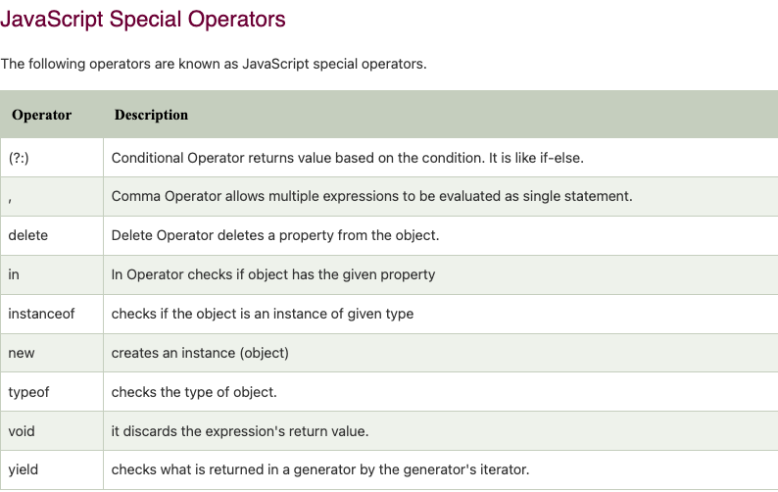

Slide 25
LOOPS
Loops are a way to repeat the same code multiple times.
The “while” loop:
The purpose of a while loop is to execute a statement or code block repeatedly as long as an expression is true. Once the expression becomes false, the loop terminates.
The while loop has the following syntax:
while (condition) {CODE}

Slide 26
The “do…while” loop
The condition check can be moved below the loop body using the do..while syntax.
The loop will first execute the body, then check the condition, and, while it’s truthy, execute it again and again.
Syntax:
do {
// loop body
} while (condition);
The “for” loop
The for loop is more complex, but it’s also the most commonly used loop.
for (begin; condition; step) {
// ... loop body ...
}

Slide 27
Functions
Functions are the main “building blocks” of the program. They allow the code to be called many times without repetition.
We’ve already seen examples of built-in functions, like alert(message), prompt(message, default) and confirm(question). But we can create functions of our own as well.
Function Declaration
To create a function we can use a function declaration.
function showMessage() {
alert( 'Hello everyone!' );
}

Slide 28
The function keyword goes first, then goes the name of the function, then a list of parameters between the parentheses (comma-separated, empty in the example ) and finally the code of the function, also named “the function body”, between curly braces.

Slide 29
JavaScript Arrow Function
Arrow function is one of the features introduced in the ES6 version of JavaScript. It allows you to create functions in a cleaner way compared to regular functions. For example,
This function
// function expression
let x = function(x, y) {
return x * y;
}
can be written as
// using arrow functions
let x = (x, y) => x * y;
using an arrow function.

Slide 30
Arrow Function Syntax
The syntax of the arrow function is:
let myFunction = (arg1, arg2, ...argN) => {
statement(s)
}
Here,myFunction is the name of the function arg1, arg2, ...argN are the function argumentsstatement(s) is the function body
If the body has single statement or expression, you can write arrow function as:
let myFunction = (arg1, arg2, ...argN) => expression

Slide 31
Java Script Objects
As we know from the chapter Data types, there are eight data types in JavaScript. Seven of them are called “primitive”, because their values contain only a single thing (be it a string or a number or whatever).
In contrast, objects are used to store keyed collections of various data and more complex entities. In JavaScript, objects penetrate almost every aspect of the language. So we must understand them first before going in-depth anywhere else.
An object can be created with figure brackets {…} with an optional list of properties. A property is a “key: value” pair, where key is a string (also called a “property name”), and value can be anything.
We can imagine an object as a cabinet with signed files. Every piece of data is stored in its file by the key. It’s easy to find a file by its name or add/remove a file.

Slide 32
An empty object (“empty cabinet”) can be created using one of two syntaxes:
let user = new Object(); // "object constructor" syntax
let user = {}; // "object literal" syntax
Usually, the figure brackets {...} are used. That declaration is called an object literal.

Slide 33
JavaScript object is a non-primitive data-type that allows you to store multiple collections of data.
Note: If you are familiar with other programming languages, JavaScript objects are a bit different. You do not need to create classes in order to create objects.
Example:
// object
const student = {
firstName: 'ram',
class: 10
};
Here, student is an object that stores values such as strings and numbers.

Slide 34
JavaScript Object Declaration
The syntax to declare an object is:
const object_name = {
key1: value1,
key2: value2 }
Accessing Object Properties:
You can access the value of a property by using its key.
1. Using dot Notation
Here's the syntax of the dot notation.
objectName.key
2. Using bracket Notation
Here is the syntax of the bracket notation.
objectName["propertyName"]

Slide 35
JavaScript Methods and this Keyword
In JavaScript, objects can also contain functions. For example,
// object containing method
const person = {
name: 'John',
greet: function() { console.log('hello'); }
};
In the above example, a person object has two keys (name and greet), which have a string value and a function value, respectively.
Hence basically, the JavaScript method is an object property that has a function value.

Slide 36
Accessing Object Methods
You can access an object method using a dot notation. The syntax is: objectName.methodKey()
You can access property by calling an objectName and a key. You can access a method by calling an objectName and a key for that method along with (). For example,
// accessing method and property
const person = {
name: 'John',
greet: function() { console.log('hello'); }
};
// accessing property
person.name; // John
// accessing method
person.greet(); // hello
Here, the greet method is accessed as person.greet() instead of person.greet.
If you try to access the method with only person.greet, it will give you a function definition.

Slide 37
JavaScript this Keyword
To access a property of an object from within a method of the same object, you need to use the this keyword. Let's consider an example.
const person = {
name: 'John',
age: 30,
// accessing name property by using this.name
greet: function() { console.log('The name is' + ' ' + this.name); }
};
person.greet();

Slide 38
In the above example, a person object is created. It contains properties (name and age) and a method greet.
In the method greet, while accessing a property of an object, this keyword is used.
In order to access the properties of an object, this keyword is used following by . and key.
Note: In JavaScript, this keyword when used with the object's method refers to the object. this is bound to an object.

Slide 39
Literals and properties
We can immediately put some properties into {...} as “key: value” pairs:
let user = { // an object
name: "John", // by key "name" store value "John"
age: 30 // by key "age" store value 30
};
A property has a key (also known as “name” or “identifier”) before the colon ":" and a value to the right of it.
In the user object, there are two properties:
The first property has the name "name" and the value "John".
The second one has the name "age" and the value 30.

Slide 40
We can add, remove and read files from it at any time.
Property values are accessible using the dot notation:
// get property values of the object:
alert( user.name ); // John
alert( user.age ); // 30
The value can be of any type. Let’s add a boolean one:
user.isAdmin = true;
To remove a property, we can use the delete operator:
delete user.age;
We can also use multiword property names, but then they must be quoted:
let user = {
name: "John",
age: 30,
"likes birds": true // multiword property name must be quoted
};

Slide 41
The last property in the list may end with a comma:
let user = {
name: "John",
age: 30,
}
That is called a “trailing” or “hanging” comma. Makes it easier to add/remove/move around properties, because all lines become alike.

Slide 42
JavaScript Constructor Function
In JavaScript, a constructor function is used to create objects. For example,
/ constructor function
function Person () {
this.name = 'John',
this.age = 23
}
// create an object
const person = new Person();
In the above example, function Person() is an object constructor function.
To create an object from a constructor function, we use the new keyword.

Slide 43
JavaScript this Keyword
In JavaScript, when this keyword is used in a constructor function, this refers to the object when the object is created. For example,
// constructor function
function Person () {
this.name = 'John',
}
// create object
const person1 = new Person();
// access properties
console.log(person1.name); // John
Hence, when an object accesses the properties, it can directly access the property as person1.name.

Slide 44
Create Objects: Constructor Function Vs Object Literal
Object Literal is generally used to create a single object. The constructor function is useful if you want to create multiple objects. For example,
// using object literal
let person = {
name: 'Sam'
}
// using constructor function
function Person () {
this.name = 'Sam'
}
let person1 = new Person();
let person2 = new Person();

Slide 45
Working With Arrays
An array is an object that can store multiple values at once. For example,
const words = ['hello', 'world', 'welcome'];
Here, words is an array. The array is storing 3 values.
Create an Array:
You can create an array using two ways:
1. Using an array literal
The easiest way to create an array is by using an array literal []. For example,
const array1 = ["eat", "sleep"];

Slide 46
2. Using the new keyword
You can also create an array using JavaScript's new keyword.
const array2 = new Array("eat", "sleep");
In both of the above examples, we have created an array having two elements.
Note: It is recommended to use array literal to create an array.

Slide 47
Here are more examples of arrays:
// empty array
const myList = [ ];
// array of numbers
const numberArray = [ 2, 4, 6, 8];
// array of strings
const stringArray = [ 'eat', 'work', 'sleep'];
// array with mixed data types
const newData = ['work', 'exercise', 1, true];

Slide 48
You can also store arrays, functions and other objects inside an array. For example,
const newData = [
{'task1': 'exercise'},
[1, 2 ,3],
function hello() { console.log('hello')}
];
Access Elements of an Array
You can access elements of an array using indices (0, 1, 2 …). For example,
const myArray = ['h', 'e', 'l', 'l', 'o'];
// first element
console.log(myArray[0]); // "h"
// second element
console.log(myArray[1]); // "e"

Slide 49
Add an Element to an Array
You can use the built-in method push() and unshift() to add elements to an array.
The push() method adds an element at the end of the array. For example,
let dailyActivities = ['eat', 'sleep'];
// add an element at the end
dailyActivities.push('exercise');
console.log(dailyActivities); // ['eat', 'sleep', 'exercise']
The unshift() method adds an element at the beginning of the array. For example,
let dailyActivities = ['eat', 'sleep'];
//add an element at the start
dailyActivities.unshift('work');
console.log(dailyActivities); // ['work', 'eat', 'sleep']

Slide 50
Change the Elements of an Array
You can also add elements or change the elements by accessing the index value.
let dailyActivities = [ 'eat', 'sleep'];
// this will add the new element 'exercise' at the 2 index
dailyActivities[2] = 'exercise';
console.log(dailyActivities); // ['eat', 'sleep', 'exercise']
Remove an Element from an Array
You can use the pop() method to remove the last element from an array. The pop() method also returns the returned value. For example,
let dailyActivities = ['work', 'eat', 'sleep', 'exercise'];
// remove the last element
dailyActivities.pop();
console.log(dailyActivities); // ['work', 'eat', 'sleep']

Slide 51
If you need to remove the first element, you can use the shift() method.
The shift() method removes the first element and also returns the removed element. For example,
let dailyActivities = ['work', 'eat', 'sleep'];
// remove the first element
dailyActivities.shift();
console.log(dailyActivities); // ['eat', 'sleep']
Array length
You can find the length of an element (the number of elements in an array) using the length property. For example,
const dailyActivities = [ 'eat', 'sleep'];
// this gives the total number of elements in an array
console.log(dailyActivities.length); // 2

Slide 52
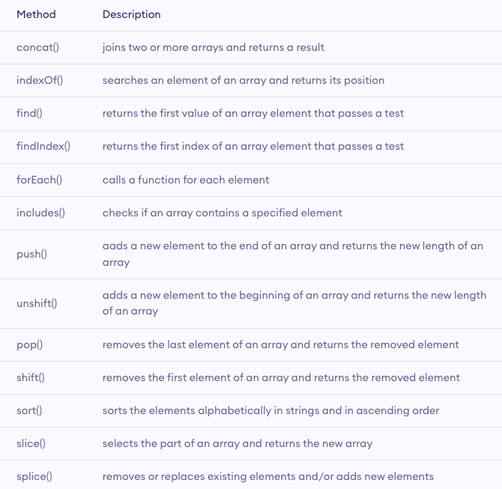
Array Methods

Slide 53
JavaScript Multidimensional Array
A multidimensional array is an array that contains another array. For example,
// multidimensional array
const data = [[1, 2, 3], [1, 3, 4], [4, 5, 6]];
Create a Multidimensional Array:
Example 1
let studentsData = [['Jack', 24], ['Sara', 23], ['Peter', 24]];
Example 2
let student1 = ['Jack', 24];
let student2 = ['Sara', 23];
let student3 = ['Peter', 24];
// multidimensional array
let studentsData = [student1, student2, student3];

Slide 54
Events
An HTML event can be something the browser does, or something a user does.
Here are some examples of HTML events:
An HTML web page has finished loading
An HTML input field was changed
An HTML button was clicked
Often, when events happen, you may want to do something.
JavaScript lets you execute code when events are detected.

Slide 55
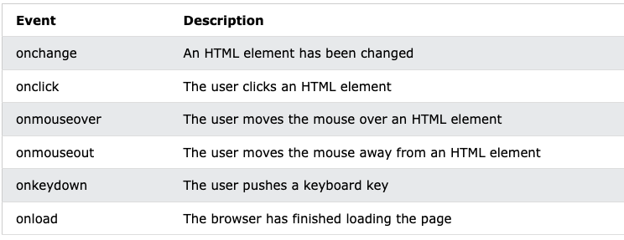
Common HTML Events
Here is a list of some common HTML events:

Slide 56
Java Script Function Example :
<html>
<head> <title>Add function</title> </head>
<body onload="add()"> // Execute a JavaScript immediately after a page has been loaded
<script>
var i=Number(prompt("Enter 1st variable"));
var j=Number(prompt("enter 2nd varialbe"));
function add()
{
document.write("the sum is ",(i+j));
}
</script>
</body>
</html>

Slide 57
Javascript Event Example:
<html>
<input type="button" value="Hover" id="btn"
onmouseover="this.style.background='red'; this.style.color='yellow'"
onmouseout="this.style.background='cadetblue'; this.style.color='white'"/>
</html>

Slide 58
Javascript Example 2 :
<html> <input type="button" value="Click me" id="btn"
onmouseover="changeColorOnMouseOver(this)"
onmouseout="changeColorOnMouseOut(this)"/>
<script type="text/javascript">
function changeColorOnMouseOver(x)
{
x.style.background='red';
x.style.color='yellow';
}
function changeColorOnMouseOut(x)
{
x.style.background='cadetblue';
x.style.color='white';
}
</script>
</html>

Slide 59
Error Handling
Types of Errors
In programming, there can be two types of errors in the code:
Syntax Error: Error in the syntax. For example, if you write consol.log('your result');, the above program throws a syntax error. The spelling of console is a mistake in the above code.
Runtime Error: This type of error occurs during the execution of the program. For example,
calling an invalid function or a variable.
These errors that occur during runtime are called exceptions. Now, let's see how you can handle these exceptions.

Slide 60
JavaScript try...catch Statement
The try...catch statement is used to handle the exceptions. Its syntax is:
try { // body of try }
catch(error) { // body of catch }
The main code is inside the try block. While executing the try block, if any error occurs, it goes to the catch block. The catch block handles the errors as per the catch statements.
If no error occurs, the code inside the try block is executed and the catch block is skipped.

Slide 61
Example 1: Display Undeclared Variable
// program to show try...catch in a program
const numerator= 100, denominator = 'a';
try {
console.log(numerator/denominator);
// forgot to define variable a
console.log(a); }
catch(error) {
console.log('An error caught');
console.log('Error message: ' + error);
}

Slide 62
JavaScript try...catch...finally Statement
You can also use the try...catch...finally statement to handle exceptions. The finally block executes both when the code runs successfully or if an error occurs.
The syntax of try...catch...finally block is:
try { // try_statements}
catch(error) { // catch_statements }
finally() { // codes that gets executed anyway}
Note: You need to use catch or finally statement after try statement. Otherwise, the program will throw an error Uncaught SyntaxError: Missing catch or finally after try.

Slide 63
Example 2: try...catch...finally Example
const numerator= 100, denominator = 'a';
try {
console.log(numerator/denominator);
console.log(a);
}
catch(error) {
console.log('An error caught');
console.log('Error message: ' + error);
}
finally {
console.log('Finally will execute every time');
}

Slide 64
JavaScript throw Statement
In JavaScript, the throw statement handles user-defined exceptions. For example, if a certain number is divided by 0, and if you need to consider Infinity as an exception, you can use the throw statement to handle that exception.
The syntax of throw statement is:
throw expression;
Here, expression specifies the value of the exception.
For example,
const number = 5;
throw number/0; // generate an exception when divided by 0

Slide 65
JavaScript throw with try...catch
The syntax of try...catch...throw is:
try { // body of try
throw exception; }
catch(error) { // body of catch }
Note: When the throw statement is executed, it exits out of the block and goes to the catch block. And the code below the throw statement is not executed.

Slide 66
Example 1: try...catch...throw Example
const number = 40;
try {
if(number > 50) {
console.log('Success');
}
else {
throw new Error('The number is low'); // user-defined throw statement
}
// if throw executes, the below code does not execute
console.log('hello');
}
catch(error) {
console.log('An error caught');
console.log('Error message: ' + error);
}

Slide 67
Java Script DOM:
With the HTML DOM, JavaScript can access and change all the elements of an HTML document.
When a web page is loaded, the browser creates a Document Object Model of the page.
With the object model, JavaScript gets all the power it needs to create dynamic HTML:
JavaScript can change all the HTML elements in the page
JavaScript can change all the HTML attributes in the page
JavaScript can change all the CSS styles in the page
JavaScript can remove existing HTML elements and attributes
JavaScript can add new HTML elements and attributes
JavaScript can react to all existing HTML events in the page
JavaScript can create new HTML events in the page

Slide 68
Changing HTML Content
The easiest way to modify the content of an HTML element is by using the innerHTML property.
To change the content of an HTML element, use this syntax:
document.getElementById(id).innerHTML = new HTML
Example
<html>
<body>
<p id="p1">Hello World!</p>
<script>
document.getElementById("p1").innerHTML = "New text!";
</script>
</body>
</html>

Slide 69
Changing the Value of an Attribute
To change the value of an HTML attribute, use this syntax:
document.getElementById(id).attribute = new value
Example
<!DOCTYPE html>
<html>
<body>
<img id="myImage" src="smiley.gif">
<script>
document.getElementById("myImage").src = "img.jpg";
</script>
</body>
</html>

Slide 70
Form Validation
<html> <head>
<script>
function validateForm() {
let x = document.forms["myForm"]["fname"].value;
if (x == "") {
alert("Name must be filled out");
return false; } }
</script>
</head>
<body>
<h2>JavaScript Validation</h2>
<form name="myForm" action="/action_page.php" onsubmit="return validateForm()" method="post">
Name: <input type="text" name="fname">
<input type="submit" value="Submit">
</form> </body></html>

Slide 71
Automatic HTML Form Validation
<!DOCTYPE html>
<html>
<body>
<h2>JavaScript Validation</h2>
<form action="/action_page.php" method="post">
<input type="text" name="fname" required>
<input type="submit" value="Submit">
</form>
<p>If you click submit, without filling out the text field,
your browser will display an error message.</p>
</body>
</html>

Slide 72
The HTML DOM is a standard object model and programming interface for HTML. It defines:
The HTML elements as objects
The properties of all HTML elements
The methods to access all HTML elements
The events for all HTML elements
In other words: The HTML DOM is a standard for how to get, change, add, or delete HTML elements.

Slide 73
Dom Object
When an HTML document is loaded into a web browser, it becomes a document object.
The document object is the root node of the HTML document.
The document object is a property of the window object.
The document object is accessed with:
window.document or document

Slide 74
Example: The url property
<!DOCTYPE html>
<html>
<body>
<h1>Window Document Object</h1>
<h2>The URL Property</h2>
<p id="p1"></p>
<script>
let url = window.document.URL;
document.getElementById("p1").innerHTML = url;
</script>
</body>
</html>

Slide 75
JavaScript - HTML DOM Methods
HTML DOM methods are actions you can perform (on HTML Elements).
HTML DOM properties are values (of HTML Elements) that you can set or change.
The DOM Programming Interface:
The HTML DOM can be accessed with JavaScript (and with other programming languages).
In the DOM, all HTML elements are defined as objects.
The programming interface is the properties and methods of each object.
A property is a value that you can get or set (like changing the content of an HTML element).
A method is an action you can do (like add or deleting an HTML element).

Slide 76
<html><body>
<p id="id"></p>
<script>
document.getElementById("id").innerHTML = "This is a paragraph";
</script></body></html>
In the example above, getElementById is a method, while innerHTML is a property.

Slide 77
The getElementById Method:
The most common way to access an HTML element is to use the id of the element.
In the example above the getElementById method used id="demo" to find the element.
The innerHTML Property
The easiest way to get the content of an element is by using the innerHTML property.
The innerHTML property is useful for getting or replacing the content of HTML elements.

Slide 78
Event Handler Using DOM
<html>
<input type="button" value="Hover" id="btn"
onmouseover="changeColorOnMouseOver()"
onmouseout="changeColorOnMouseOut()"/>
<script type="text/javascript">
function changeColorOnMouseOver()
{
document.getElementById("btn").style.background='red';
document.getElementById("btn").style.color='yellow';
}
function changeColorOnMouseOut()
{
document.getElementById("btn").style.background='cadetblue';
document.getElementById("btn").style.color='white';}</script></html>

Slide 79
JavaScript HTML DOM EventListener
The addEventListener() method:
The addEventListener() method attaches an event handler to the specified element.
The addEventListener() method attaches an event handler to an element without overwriting existing event handlers.
You can add many event handlers to one element.
You can add many event handlers of the same type to one element, i.e two "click" events.
You can add event listeners to any DOM object not only HTML elements. i.e the window object.
The addEventListener() method makes it easier to control how the event reacts to bubbling.
When using the addEventListener() method, the JavaScript is separated from the HTML markup, for better readability and allows you to add event listeners even when you do not control the HTML markup.
You can easily remove an event listener by using the removeEventListener() method.

Slide 80
Syntax:
element.addEventListener(event, function);
The first parameter is the type of the event (like "click" or "mousedown" or any other HTML DOM Event.)
The second parameter is the function we want to call when the event occurs.

Slide 81
<!DOCTYPE html>
<html>
<body>
<h2>JavaScript addEventListener()</h2>
<p>This example uses the addEventListener() method to execute a function when a user clicks on a button.</p>
<button id="myBtn">Try it</button>
<script>
document.getElementById("myBtn").addEventListener("click", myFunction);
function myFunction() {
alert ("Hello World!");
}
</script>
</body>
</html>

Slide 82
Example :
<!DOCTYPE html>
<html>
<body>
<h2>JavaScript addEventListener()</h2>
<p>This example uses the addEventListener() method to attach a click event to a button.</p>
<button id="myBtn">Try it</button>
<p id="demo"></p>
<script>
document.getElementById("myBtn").addEventListener("click", displayDate());
function displayDate() {
document.getElementById("demo").innerHTML = Date();}
</script>
</body>
</html>

Slide 83
Add Many Event Handlers to the Same Element
<!DOCTYPE html>
<html>
<body>
<h2>JavaScript addEventListener()</h2>
<p>This example uses the addEventListener() method to add many events on the same button.</p>
<button id="myBtn">Try it</button>
<p id="demo"></p> <script>
var x = document.getElementById("myBtn");
x.addEventListener("mouseover", myFunction);
x.addEventListener("click", mySecondFunction);
x.addEventListener("mouseout", myThirdFunction);
function myFunction() {
document.getElementById("demo").innerHTML += "Moused over!<br>";
}
function mySecondFunction() {
document.getElementById("demo").innerHTML += "Clicked!<br>";
}
function myThirdFunction() {
document.getElementById("demo").innerHTML += "Moused out!<br>";
} </script> </body> </html>

Slide 84
Using the removeEventListener() method
The Javascript removeEventListener() is an inbuilt function that is used to remove removes an event handler that was previously added using the addEventListener() function from the element.
element.removeEventListener(event, listener)

